Slide 1
Handout #1

Slide 2
Handout #2

Slide 3
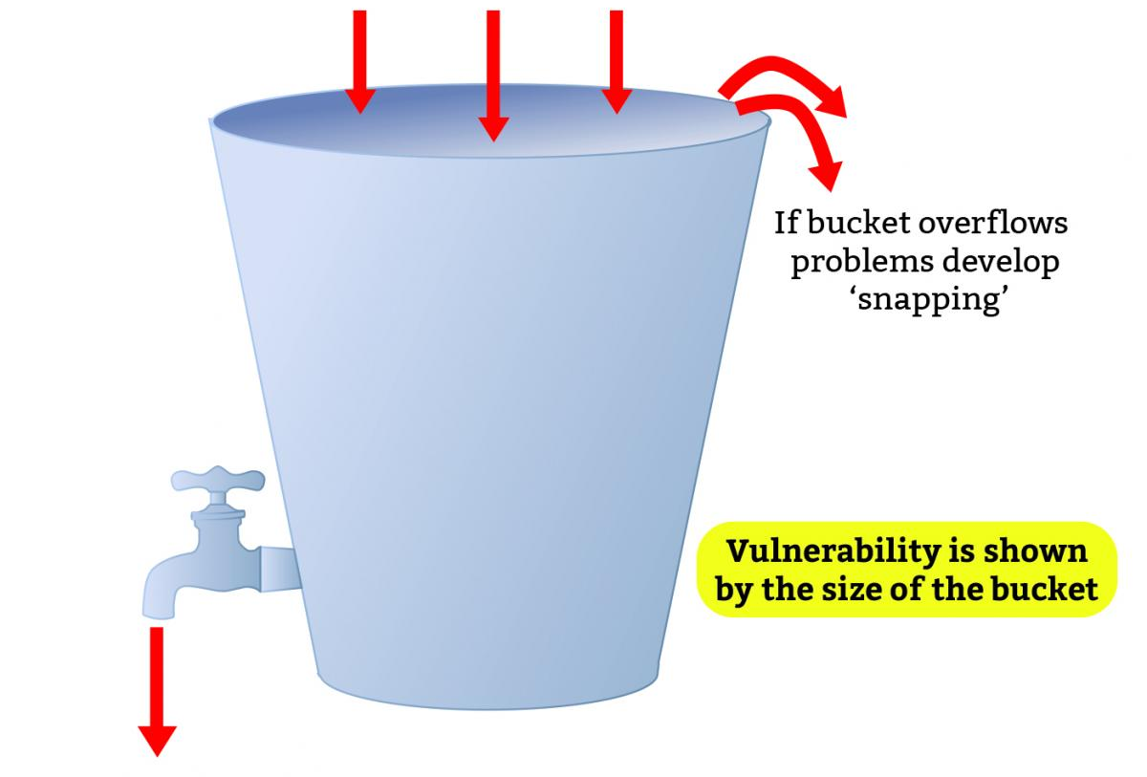
Handout #3

Slide 4
Handout #4
What If?
Scenario One.. What if you were out with friends on a Saturday afternoon and you missed the last train home. What is your Plan B,C,D,E ? Brainstorm your ideas using the circles below | Scenario Two... Create your own scenario… ___________________________________________________________ ___________________________________________________________ Use the template below to brainstorm your own Plan B’s for your own developed scenarios.

Slide 5
Handout #5
5 Senses
Take a deep breath in a quiet space
Say out loud:
5 things you can see
4 things you can hear (close your eyes while you do this and really hone into new sounds)
3 things you can touch (this could be the feel of your clothes, the desk, the breeze from the window)
2 things you can smell (if you were doing this at home it could be that you are bringing a cup of tea up to your nose or smelling a candle)
1 thing you can taste
This exercise will put you back in touch with your senses and ground you.
What can I do I feel overwhelmed?
COPING STRATEGIES

Slide 6
Handout #6
7-11
Breathe in for a count of 7 seconds
Hold breath for 2 seconds
Breathe out for a count of 11 seconds
Repeat 3 times
Take a break
Repeat exercise twice more
Do this every morning and night
Note: If you find this difficult, simply make sure that you are breathing out for longer than you are breathing in.
What can I do I feel overwhelmed?
COPING STRATEGIES

Slide 7
Handout #7
CONTACTS
Anxious? Worried? Stressed?
Get 24/7 help from
Speak confidentially via text to a trained professional
TEXT: 85258
It is free and confidential to text this service from the following major networks: EE, O2, Three, Vodafone, BT Mobile, Tesco Mobile, Virgin Mobile, iD Mobile, Sky, Telecom Plus, Lebara and GiffGaff.

